Slide 1
The History of the Schultüte
Schultüten have been given to German kids on their first day of school since around 1810. This tradition started in big German cities such as Jena, Dresden and Leipzig.

Slide 2
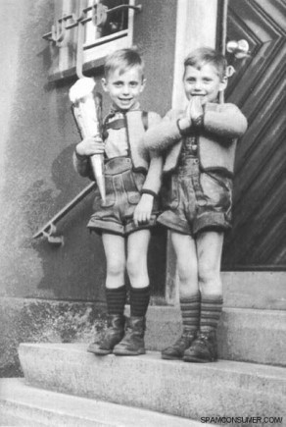
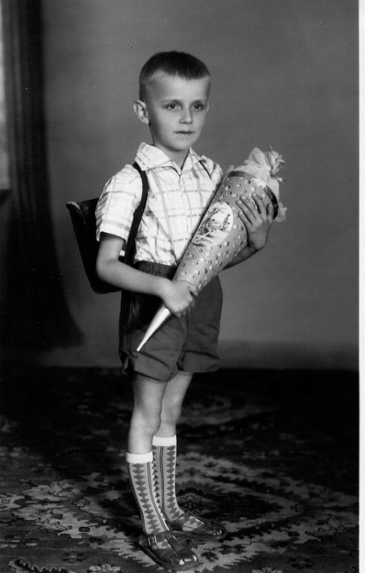
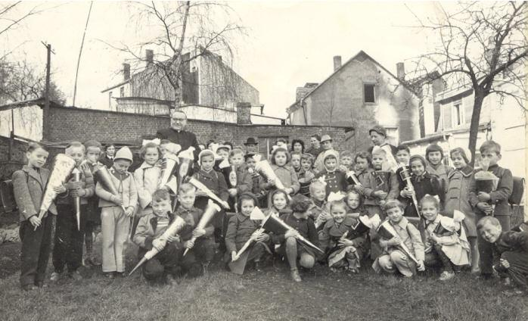

Slide 3
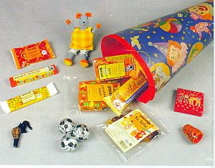
Schultüten are colorful cones which come in different sizes. They are filled with treats, little presents, and goodies. Parents give them to children to celebrate their first day of school.

Slide 4
